Slide 1
Advanced Data Analytics using R
Project – 1
Breaking The Model
- Venkatesh Ramanathan

Slide 2
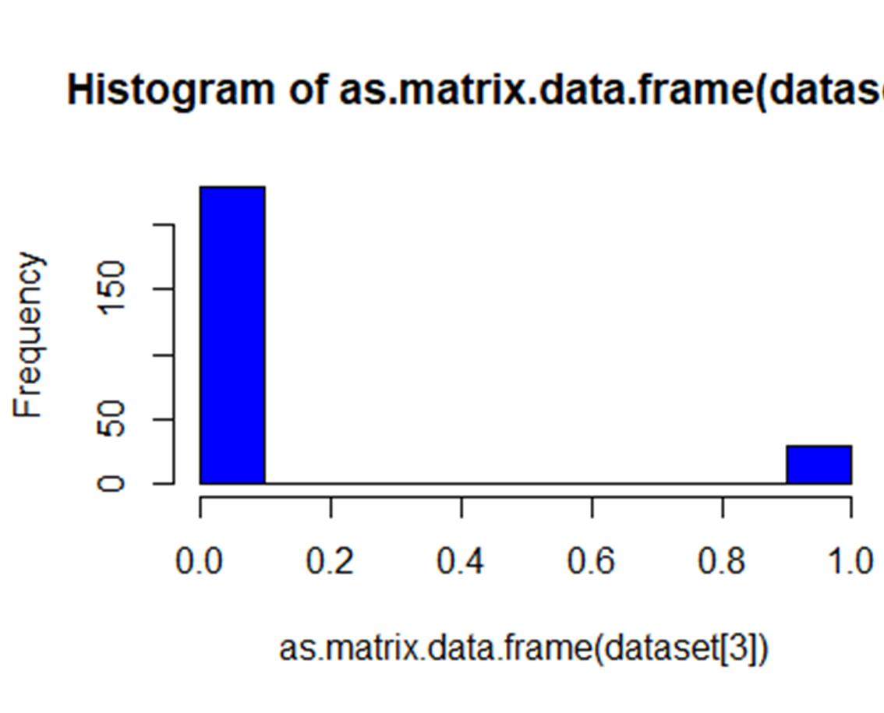
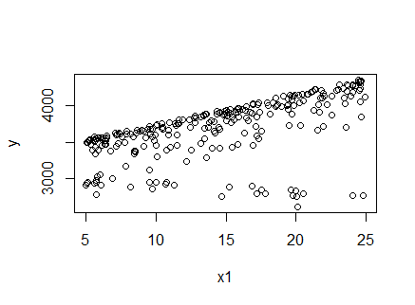
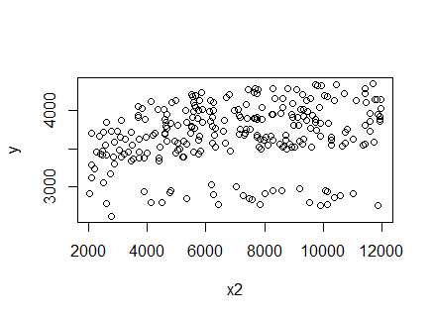
Plot(Dataset) #Dataset12.csv
N = 260
Rebate – Median: 14.541 , Mean: 14.345, Min: 5.013, Max: 24.942
Ad - Median : 7130, Mean: 6995, Min: 2035, Max :11976
X- mas: Mean: 0.1154, #0’s : 30
Sales - Median: 3718, Mean: 3687 , Max: 4365, Min: 2602

Slide 3
Full Model
b₀ + ( b₁*(1 – e ^{– r}₁ ^{* rebate}) / r₁ ) + ( b₂*(1 – e ^{–r}₂ ^{* Ad}) / r₂ ) + ( b₃*xmas) +
( b₄ * xmas *rebate ) + ( b₅ * xmas * Ad ) + (b₆ * rebate * Ad)
$Par
$objective = 2061588
b₀ | b₁ | ^{r}₁ | ^{r}₂ | b₂ | b₃ | b₄ | b₅ | b₆
182.2383 | 14.8027 | - 0.02342 | 0.0241 | 74.0515 | 42.8172 | - 52.7899 | - 0.0326 | 0.0028

Slide 4
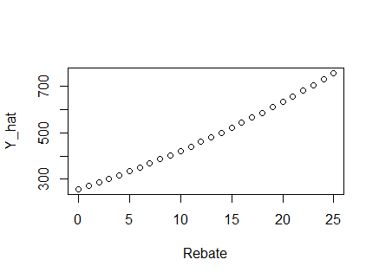
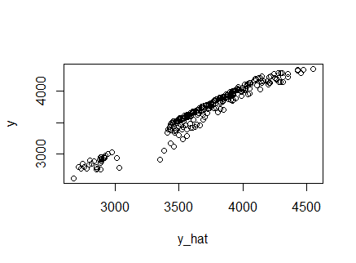
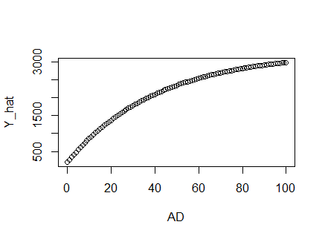
Y-hat Vs. Y

Slide 5
P - Value & Selected Model
b₀ | b₁ | b₂ | b₃ | b₄ | b₅ | b₆ | r₁ | r₂
0 | 0 | 0.5984 | 0 | 0 | 0 | 0 | 0.5508 | 0.002
Selection Criteria : -
If SSR _{restricted model} < SSR _{unrestricted model}
Exclude parameters from the model if my P – value is greater that 0.05.
182.2383 + 14.8027 + (42.8172 * xmas) + (- 52.7899 * xmas *rebate ) + (- 0.0326 * xmas * Ad ) + (0.0028 * rebate * Ad)

Slide 6
Insights & Proposal
For every ‘$’ spent on rebate, the sales of the product increases by 14$. ( b₁ )
On Xmas, the product sales increases by $42 ( b₃ )
For every ‘$’ spent on rebate during Christmas saw a difference in sales of 52$ ( b₄ )
For every ‘$’ spent on Ads during Christmas saw a difference in sales of 0.03$ ( b₅ )
For every ‘$’ spent on Ads for rebate saw an increase in sales of 0.0028$ ( b₆ )
Encourage on rebate and even on it’s interaction with Ads when it is not Christmas to increase sales.
Introduce new products right before Christmas and increase the product sales during Xmas

Slide 7
Thank you!
Questions?

